Slide 1
SVA: Shape variation analyzer for TMJ OA
Presented by: Juan Carlos Prieto
Collaborators:
UMICH: Lucia Cevidanes, Clément Mirabel, Priscille de Dumast, Nina Tubau, Loic Mïchoud
UNC: Chao Huang

Slide 2
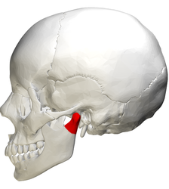
Introduction
Temporomandibular Joint Osteoarthritis (TMJ OA):
OA affects 15% of adults
Complex pathogenesis.
Symptoms are different from patient to patient.
Pain, limited jaw movement, grinding, clicking.
May repair and adapt or go into aggressive bone destruction.
Notes:
Different patterns of bone resorption and formation.
May repair and adapt or go into aggressive bone destruction.
Including pain, limited jaw movement, grinding, clicking, and deviation on opening.

Slide 3
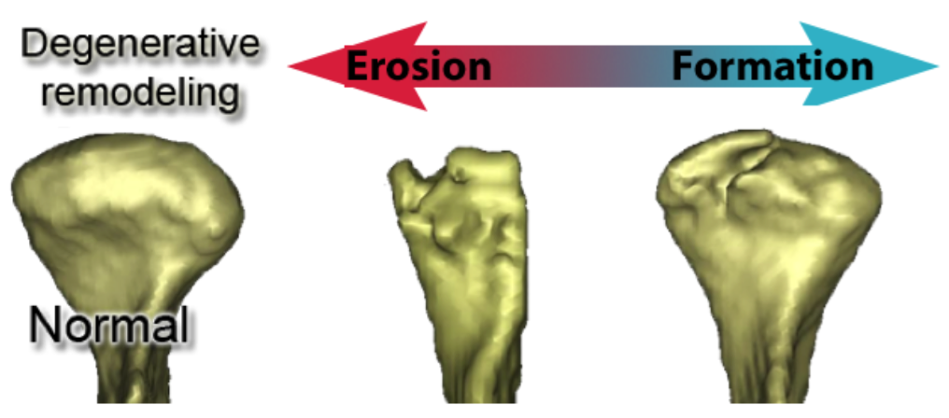
Introduction
No disease-modifying therapy exists for OA.
A biomarker is needed
Signal morphological and pathological changes.
Usable in earliest stages of OA throughout the course of the disease.
Disease treatment focused on pain management.
Notes:
The orofacial pain specialist is familiar with the different presentations of osteoarthritis and can coordinate the different specialties necessary to manage the problem.
Diverse specialties of rheumatology, orofacial pain, physical therapy, and psychology
With the advent of new scientific and clinical knowledge, we are entering a new era of increased awareness, improved care, and improved quality of life for people afflicted with OA.

Slide 4
Materials
3D Surface representation for 293 condyles (105 Control and 154 with diagnosis of TMJ OA)
Cone Beam Computed Tomography (CBCT)
0.08 mm isotropic voxel size, 4cm x 4cm field of view scan using the 3D Accuitomo 170, Morita Corp.
Saliva samples
3 ml or 15 min maximum.
Aliquoted to exactly 2 ml and an inhibitor protease (Aprotinin + PMSF) was added.
Blood samples
4 ml
Cells removed from plasma by centrifugation
Saliva and serum samples evaluation
Quantibody protein microarrays RayBiotech (Norcross, GA)
17 biomarkers were expressed
Notes:
The biomarkers chosen were known to be associated with bone repair and degradation, inflammation or nociception, common processes seen in OA. Preprocessing steps for these samples were completed at the School of Dentistry and then shipped to RayBiotech for analysis. All samples were evaluated in duplicate for level of proteins 6ckine, ANG, BDNF, CXCL16, ENA-78, GM-CSF, IFNγ, IL-1α, IL-6, MMP-3, MMP-7, PAI-1, TGFβ1, TIMP-1, TNFα, VE-Cadherin and VEGF.

Slide 5
Objectives
The goal of this work is to develop a noninvasive technique to provide information about bony changes and disease changing in TMJ OA
Integrate Heterogeneous data sources
Shape Variation Analyzer:
Classify condyles by the severity of the shape changes using deep neural networks.
Multivariate Functional Shape Data Analysis
Build association between multivariate shape measurements and demographic information
Notes:
Given the complexity of such heterogeneous conditions and current clinical, biological and imaging data in arthritis of the temporomandibular joint, there is a compelling need for more efficient software tools to facilitate these analyses.
Recent studies have demonstrated the difficulties to replicate scientific findings and/or experiments published in past.1
To answer this challenge, we developed Shape Variation Analyzer (SVA) using a neural network to classify morphological variations using 3D models of the mandibular condyle.
The effects seen in the replicated experiments were smaller than previously reported. Some of the explanations for these findings include the complexity of the experimental design and the pressure on researches to report positive findings.
The International Committee of Medical Journal Editors (ICMJE) suggests that every study considered for publication must submit a plan to share the de-identified patient data no later than 6 months after publication.
There is a growing demand to enhance the management of clinical data, facilitate data sharing across institutions and also to keep track of the data from previous experiments.

Slide 6
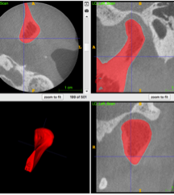
SVA: Shape variation analyzer – Priscille de Dumast, Nina Tubau
Objective:
Develop a non-invasive technique to provide information about shape changes in TMJ OA.
Classify 3D models into 7 groups generated by consensus between two clinician experts.
Challenges:
Number of training samples
Select appropriate geometric features from the 3D models

Slide 7
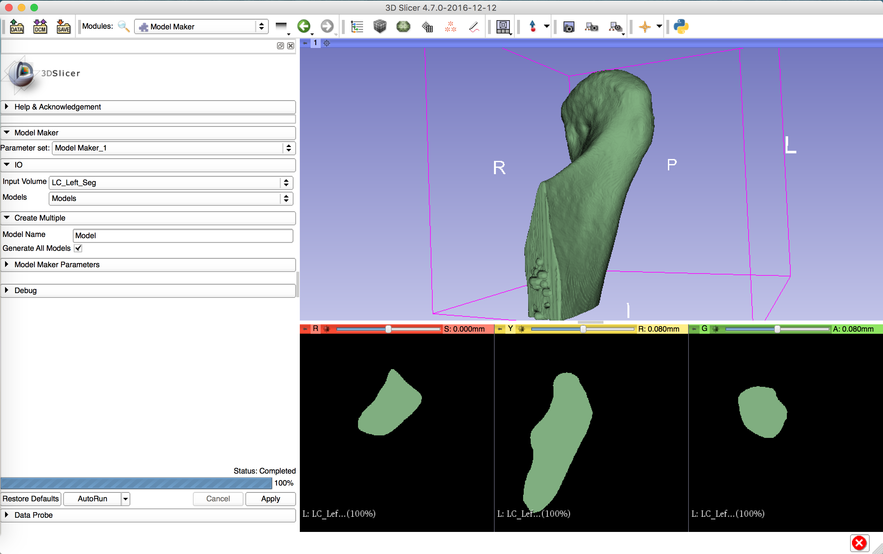
SVA: Shape Variation Analyzer
SVA is new tool to analyze shape variation using deep neural networks.
Learn abstract patterns in the data
Include purely geometric information
Classify condyles in 7 different groups

Slide 9
Building SVA Model
Label map
SPHARM
Groups
Segmentation
Extract features
Training
Generate New Shapes. Balance the Classes!
Classification

Slide 10
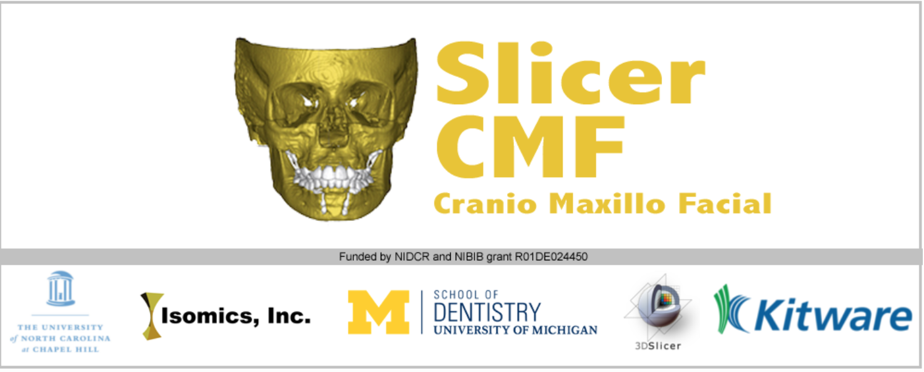
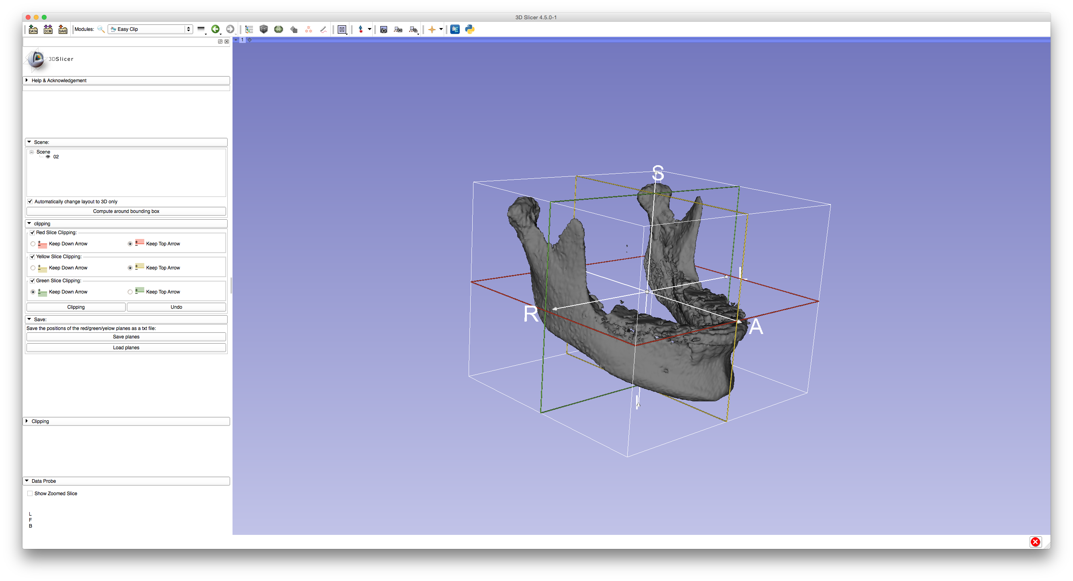
Apply Matrix
Downsize
Label Addition
Label Extration
Landmark Registration
Surface Registration
Voxel Based Registration
Growing Registration
Non-Growing Registration
Mask Creation
https://sites.google.com/a/umich.edu/dentistry-image-computing/Download

Slide 11
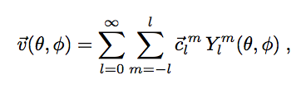
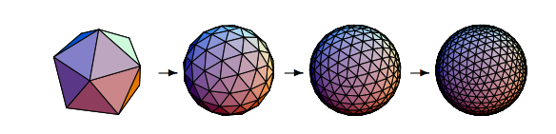
SPHARM-PDM
Can only represent objects of spherical topology
Optimize an equal area mapping of 3D voxel mesh onto the sphere
Notes:
A spherical parametrization is computed for the surface meshes using a area-preserving, distortion minimizing spherical mapping.
Using the first order ellipsoid from the spherical harmonic coefficients, the spherical parametrizations are aligned to establish correspondence across all surfaces. The SPHARM description is then sampled into a triangulated surfaces (SPHARM-PDM) via icosahedron subdivision of the spherical parametrization.

Slide 12
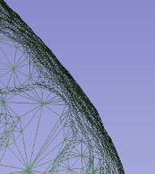
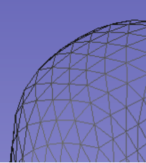
SPHARM-PDM

Slide 13
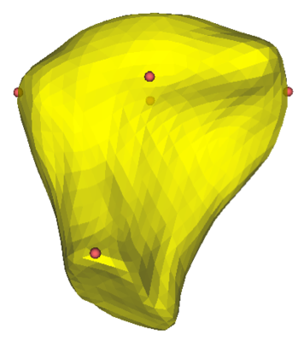
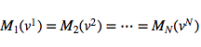
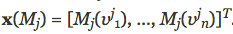
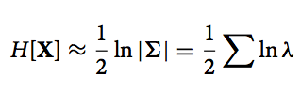
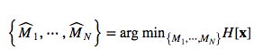
GROUPS
Improve shape correspondence
Entropy terms computed over the landmark distribution
Entropy
Notes:
M is a continuous mapping functions of correspondences that map surfaces in a common reference space (sphere).
X(M_i) is a vector of corresponding points of subject j deformed by M_i
The landmarks are use to constrain the optimization and only those have full correspondence across all cortical surfaces.
Is assumed that x(M_j) are instances of X drawn from a probability density function p(X).
The amount of information in the random sampling is given by the entropy function
For the density estimation, We assume a multivariate Gaussian distribution with covariance Sigma and therefore, the entropy is obtained by H
Lambda are the eigenvalues of Sigma

Slide 14
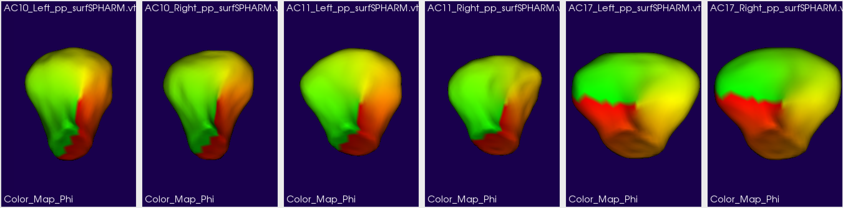
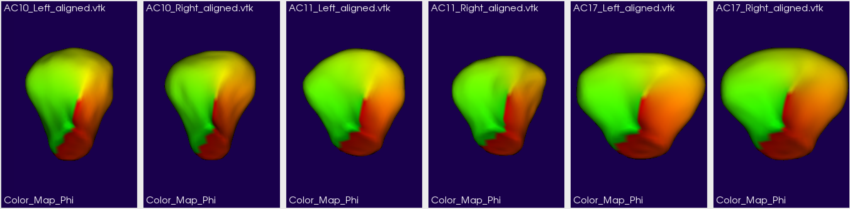
GROUPS – Aligned surfaces

Slide 15
Principal component analysis on each class
PCA on each group
Keep coefficients that represent 98% of the variation
Compact representation of the data
Use a random variable to generate new shapes for a given class

Slide 16
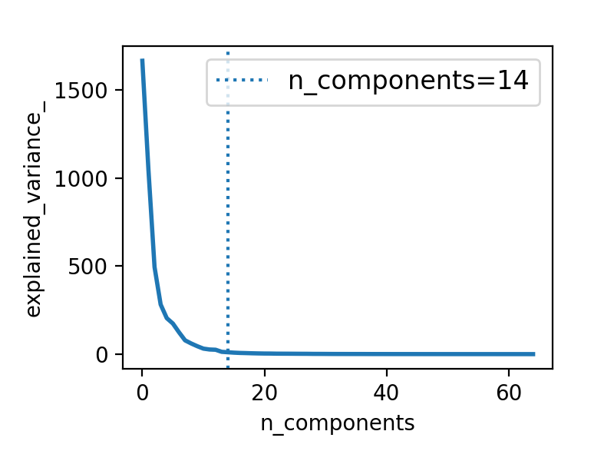
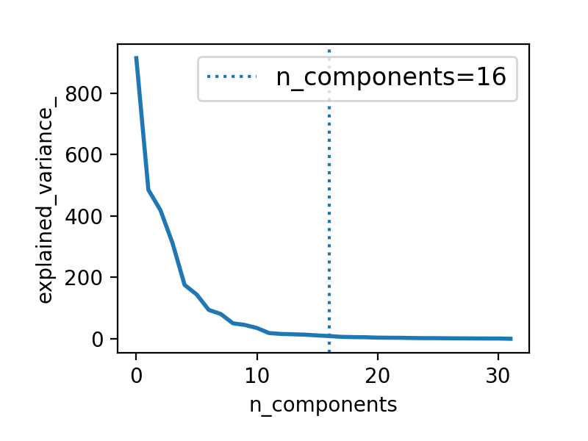
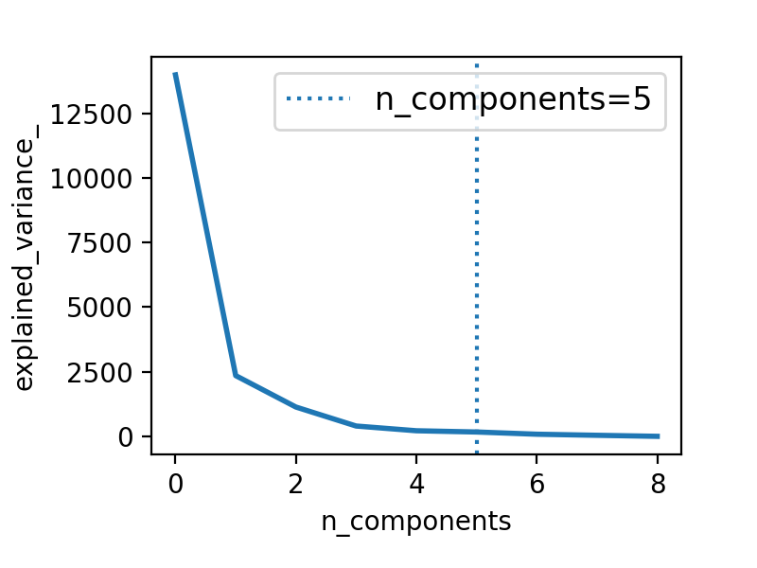
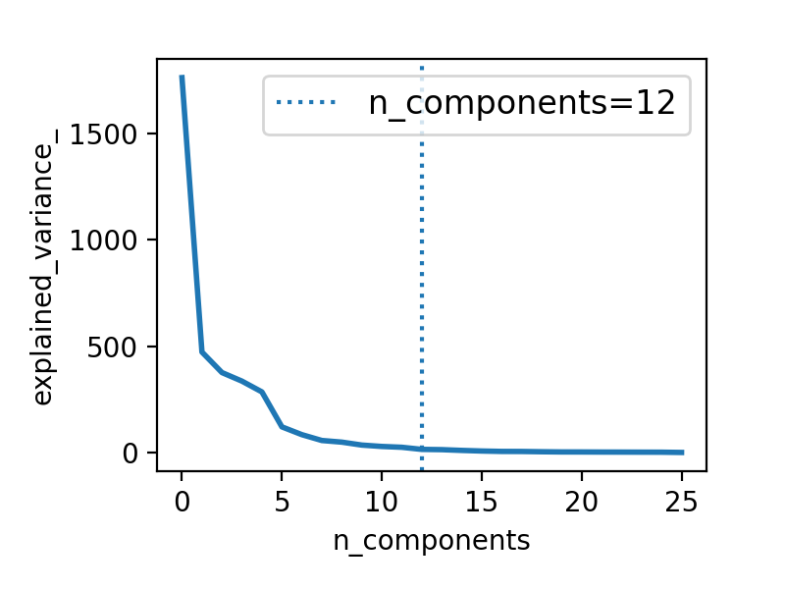
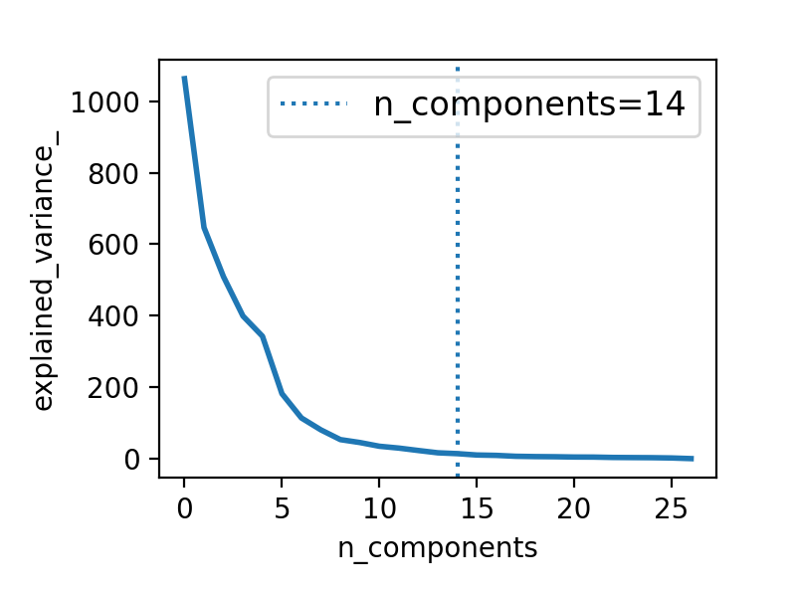
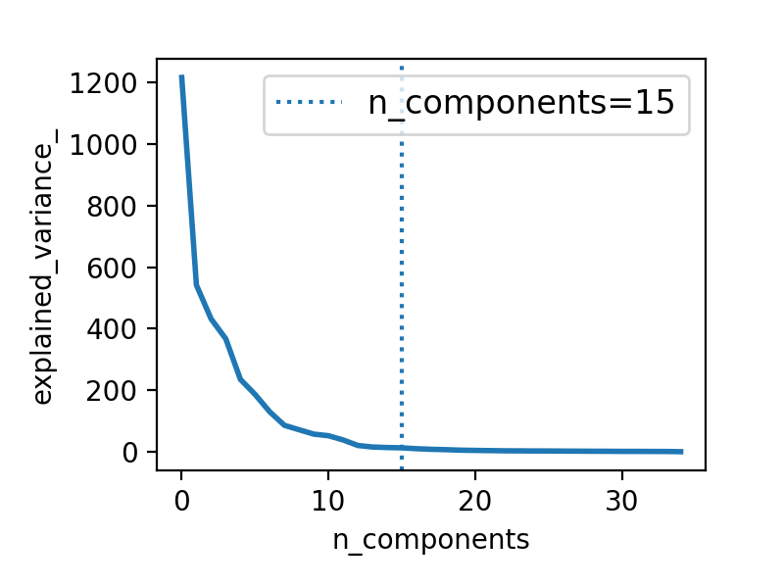
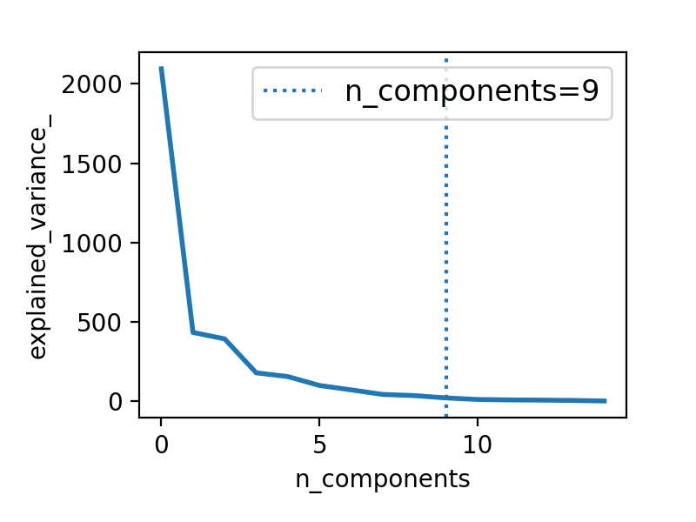

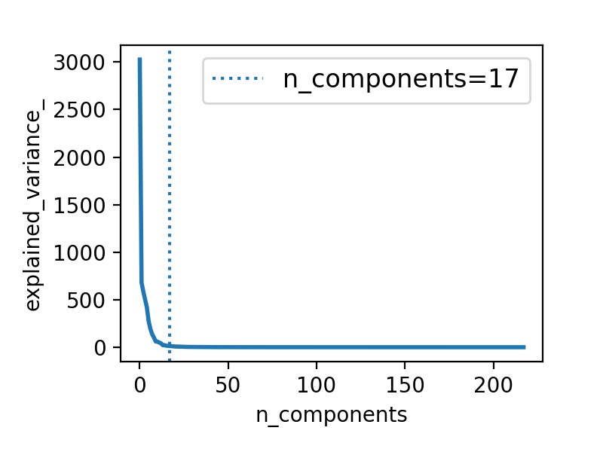
G00
G01
G02
G03
G04
G05
G06
G07
All
Notes:
PCA n_components is chose so it explains 98% of variance

Slide 17
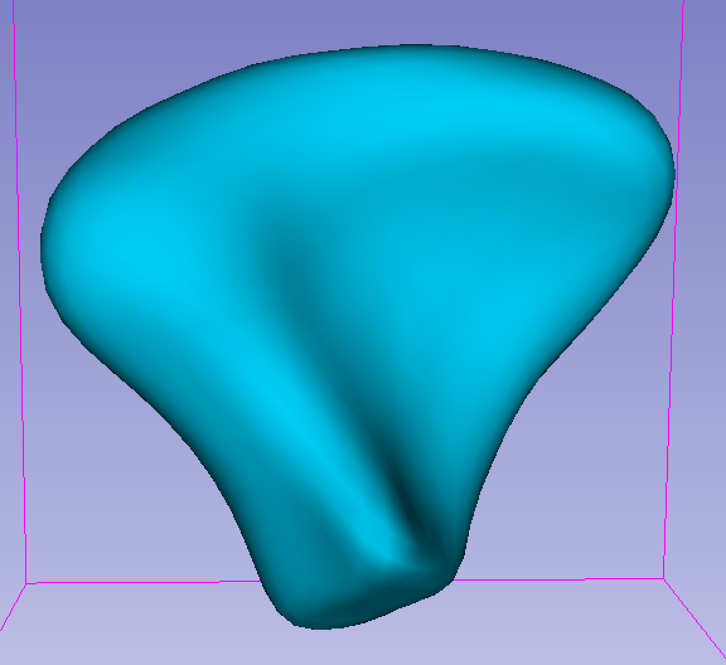
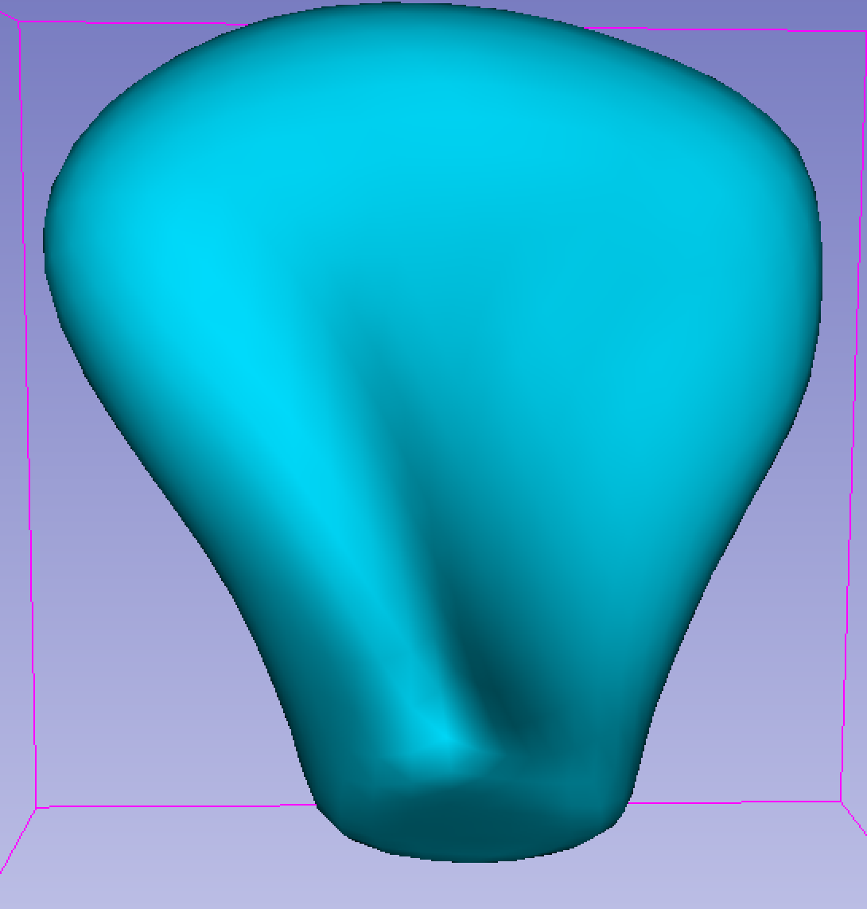
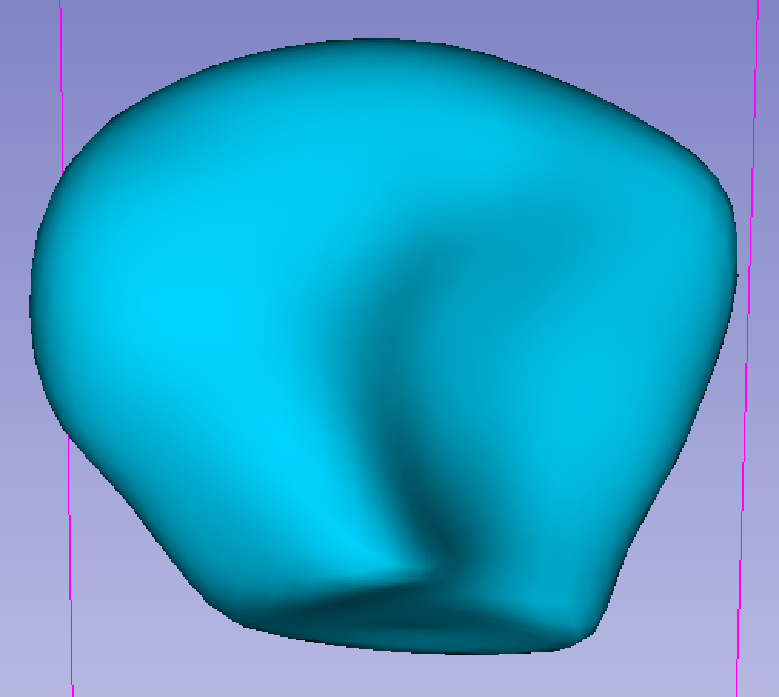
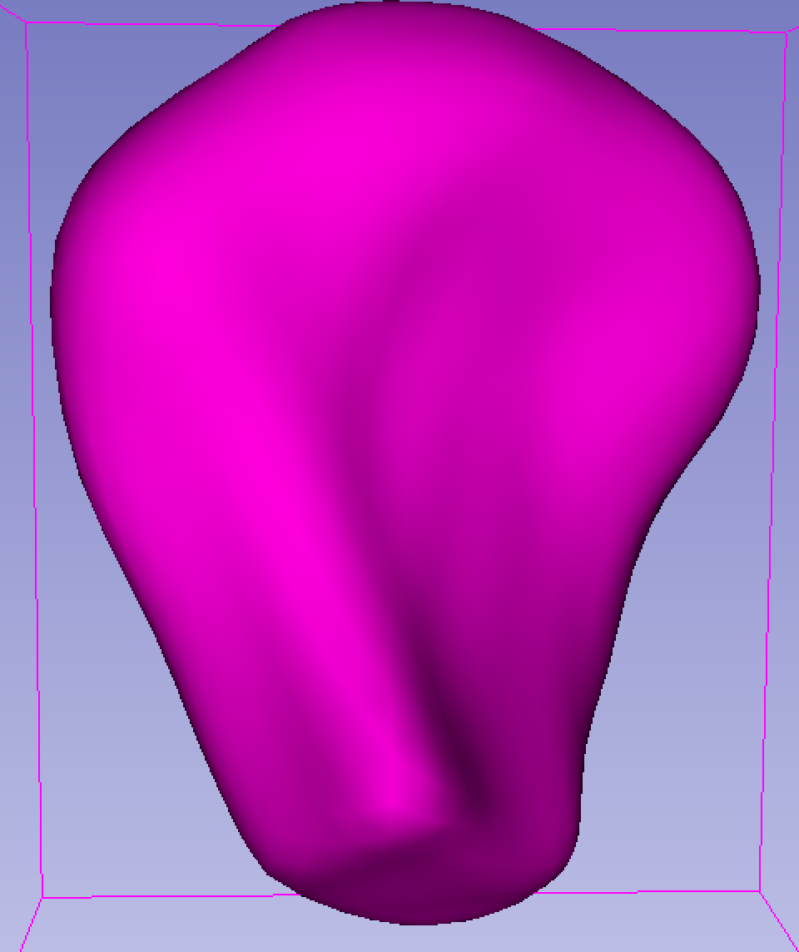
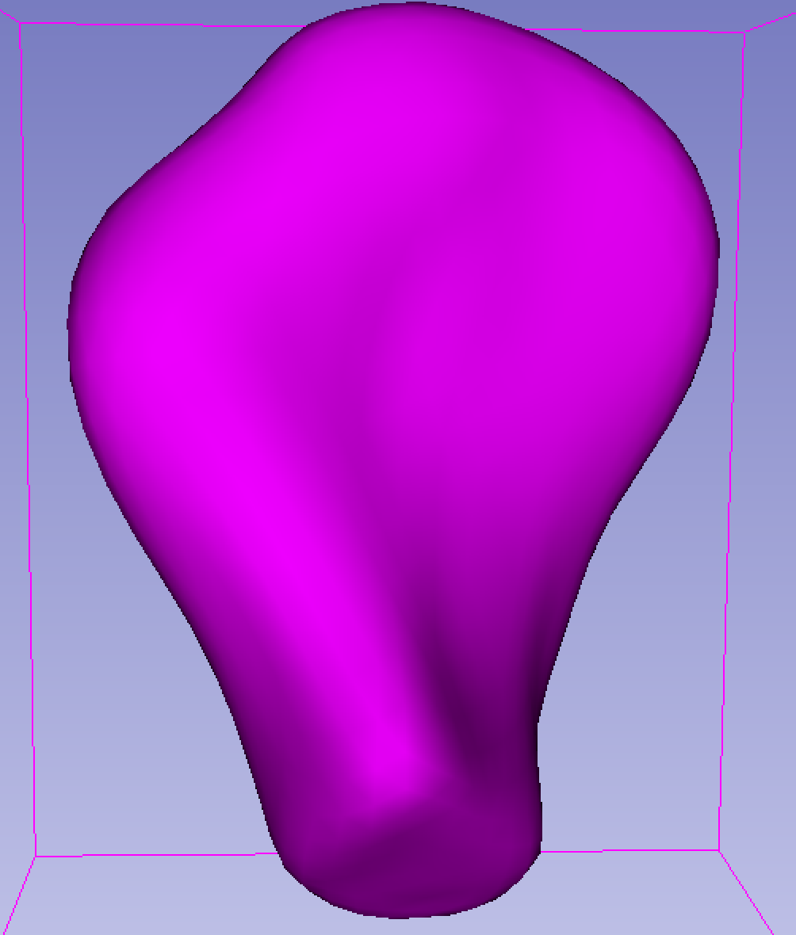
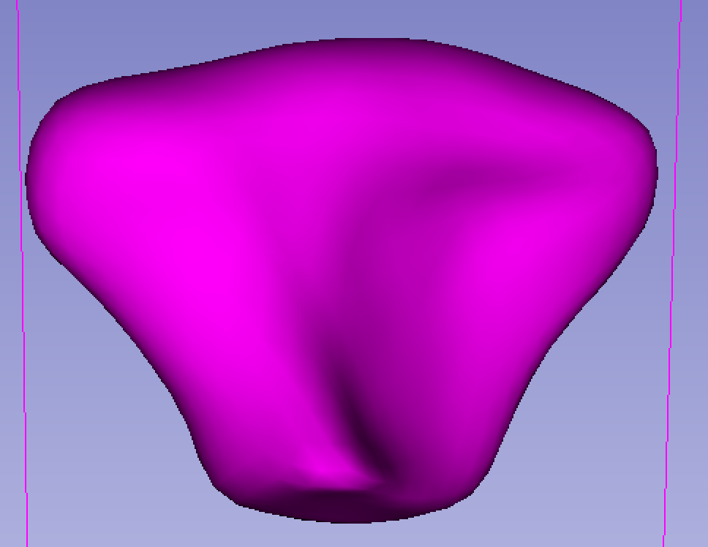
Generating Shapes using PCA reconstruction
alpha = 2.0*(np.random.random_sample(np.size(X_pca_))) - 1.0
data_compressed = 1.5*X_pca_var * alpha
data_generated = pca.inverse_transform(data_compressed) + X_

Slide 18
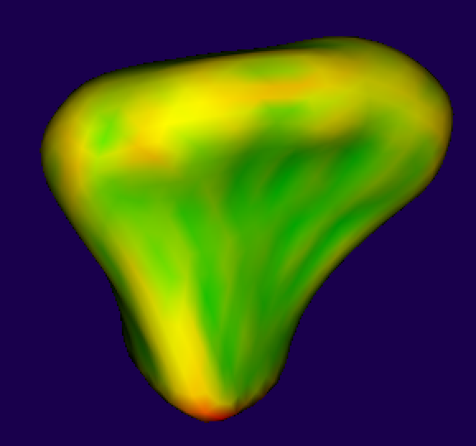
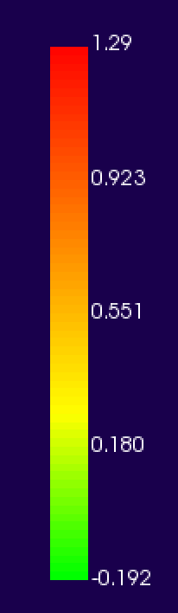
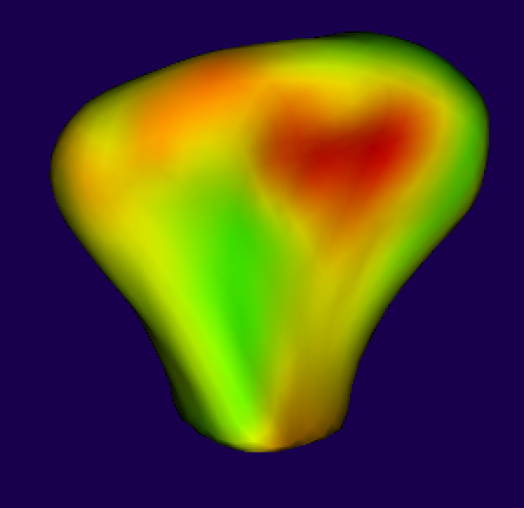
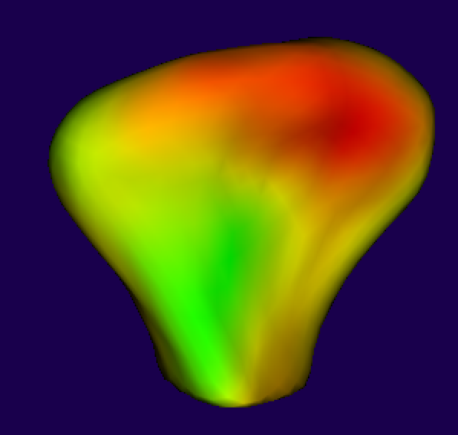
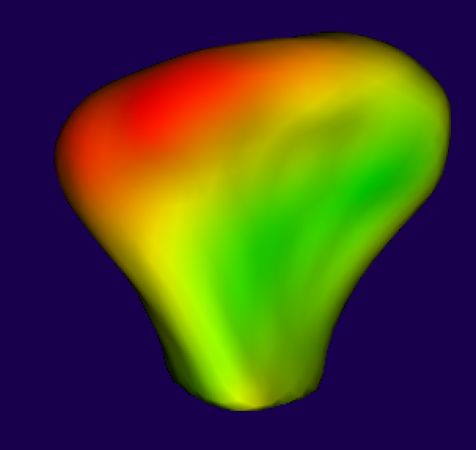
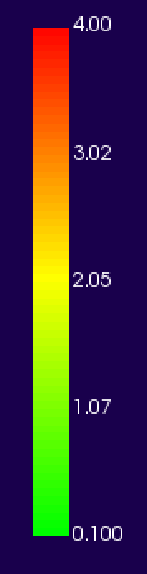
Feature extraction
Distance to group mean
Mean curvature
Maximum curvature
Minimum curvature
Gauss curvature
Distance G00
Distance G02
Distance G04

Slide 19
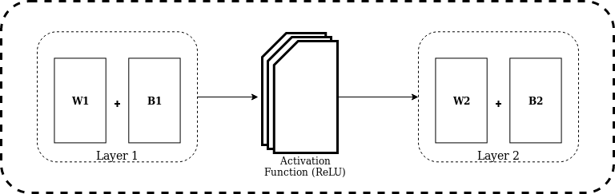

Deep learning classification
Train a network to classify condyles into a category
5 Fully connected layers
Drop out 0.5
Regularization

Slide 20
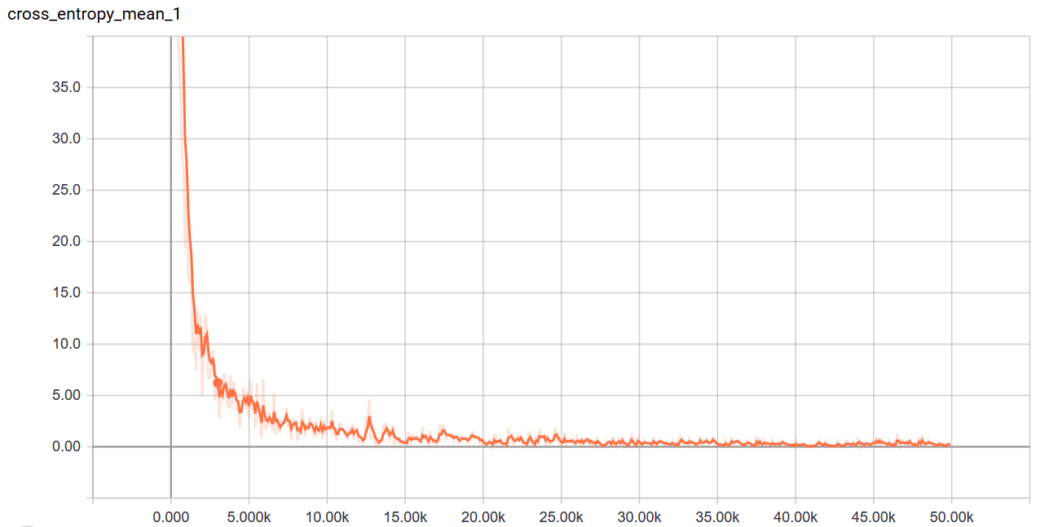
Neural Network Training

Slide 21
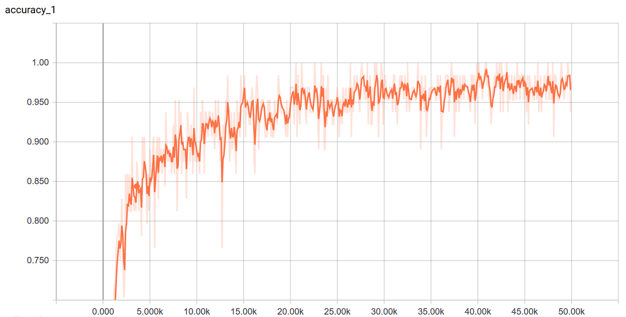
Neural Network Accuracy during training

Slide 22
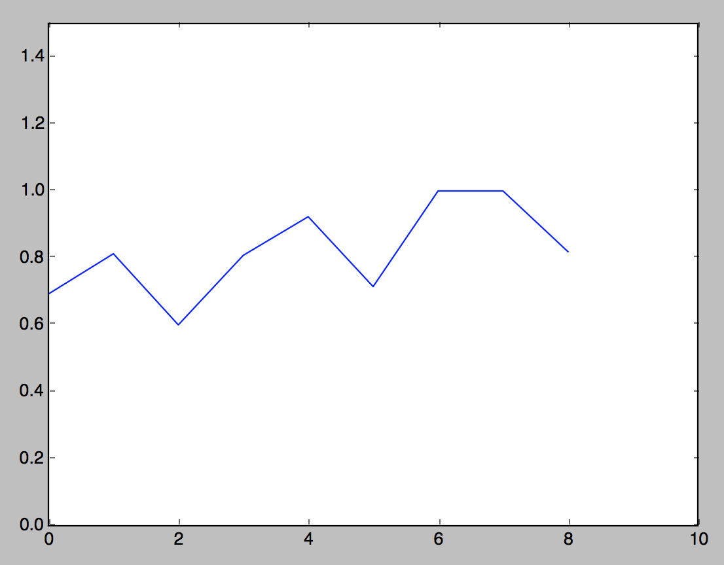
Classification results on original data

Slide 23
Fit original data using Active Shape Model
def cost_fit(x):
points = pca.inverse_transform(x.reshape(1, -1))
points += X_
points = points.reshape(-1).reshape(-1, 3)
costdiff = []
for p in points:
pid = pointlocator.FindClosestPoint(p)
shapepoint = shapepoints.GetPoint(pid)
costdiff.append(p - shapepoint)
return np.array(costdiff).reshape(-1)

Slide 24
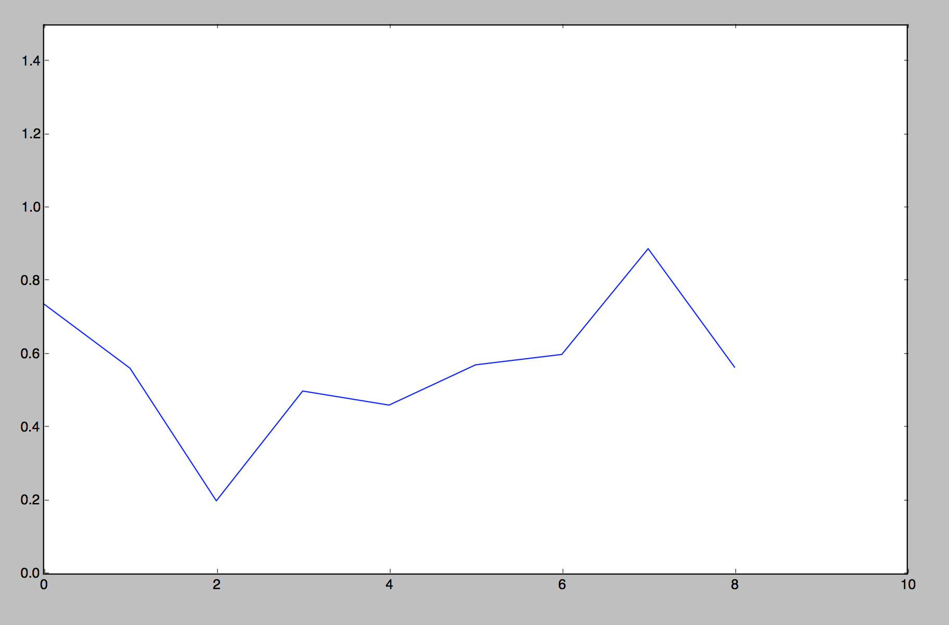
Classification results on fitted data

Slide 25
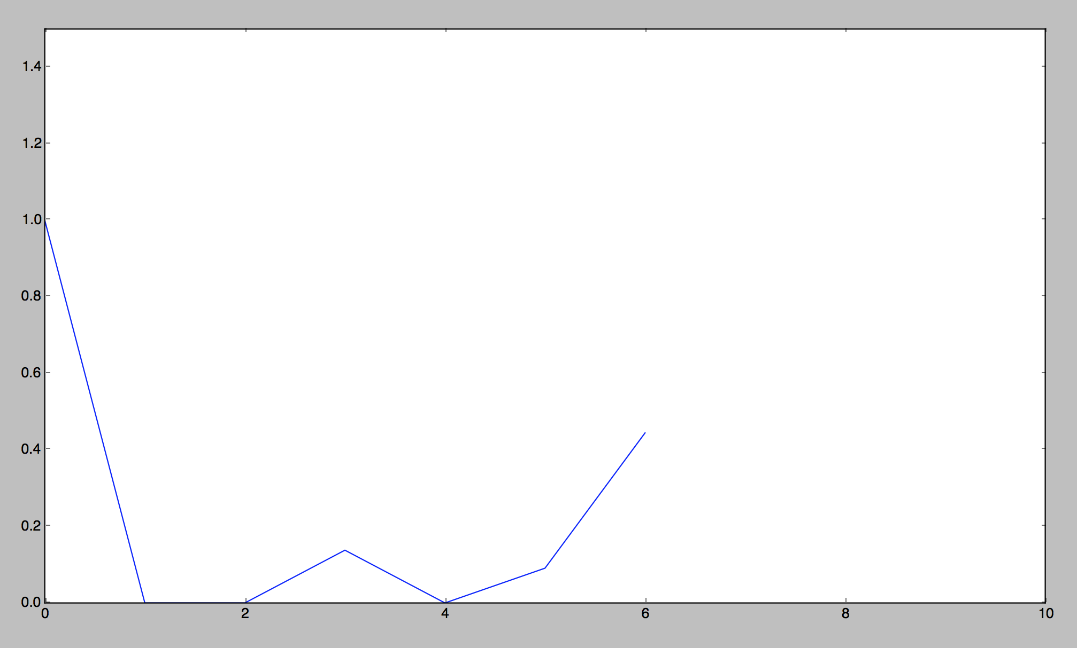
Classification results on test data

Slide 26
Conclusion SVA
Use only geometric features.
Classification approach seems promising
Enhance our understanding about shape changes that TMJ OA patients undergo during the course of the disease.
Future work
Use different shape descriptors
Heat kernel signature
PCA vs. KernelPCA vs. PNS

Slide 27
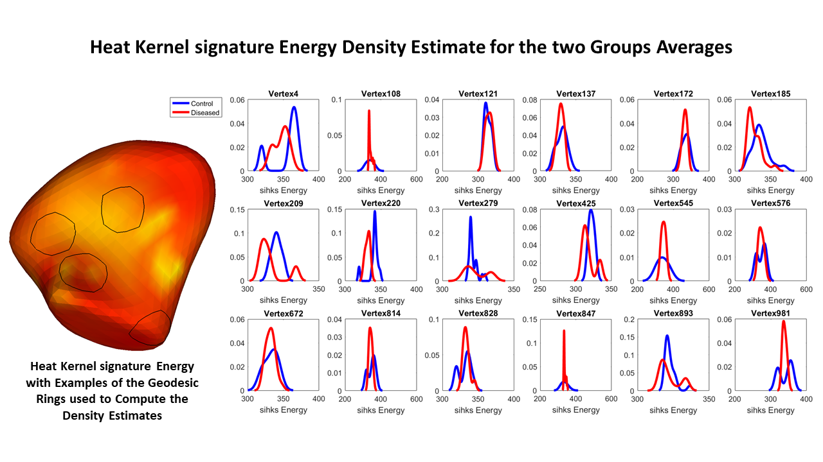
Heat Kernel signature

